Slide 1
Covalent Bonding

Slide 2
Valence Bond Theory
The first quantum mechanical model of chemical bonding, known as valence bond theory (VBT), which was first developed by the German duo Heitler and London and later popularized by Linus Pauling and Slater.
VBT is a localized bonding model that expands on the Lewis concept of electron pairs serving as the “glue” that holds the nuclei together in chemical bonds

Slide 3
According to valence bond theory, atoms share electrons when their atomic orbitals overlap
Each of the overlapping atomic orbitals must contain a single, unpaired electron
Furthermore, the two electrons shared by the bonded atoms must have opposite spins
The nuclei of both atoms are attracted to the shared pair of electrons. It is this mutual attraction for the shared electrons that holds the atoms together

Slide 4
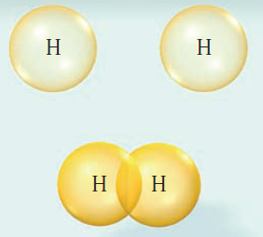
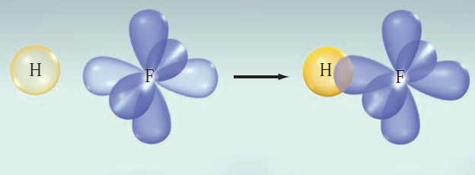

Slide 5
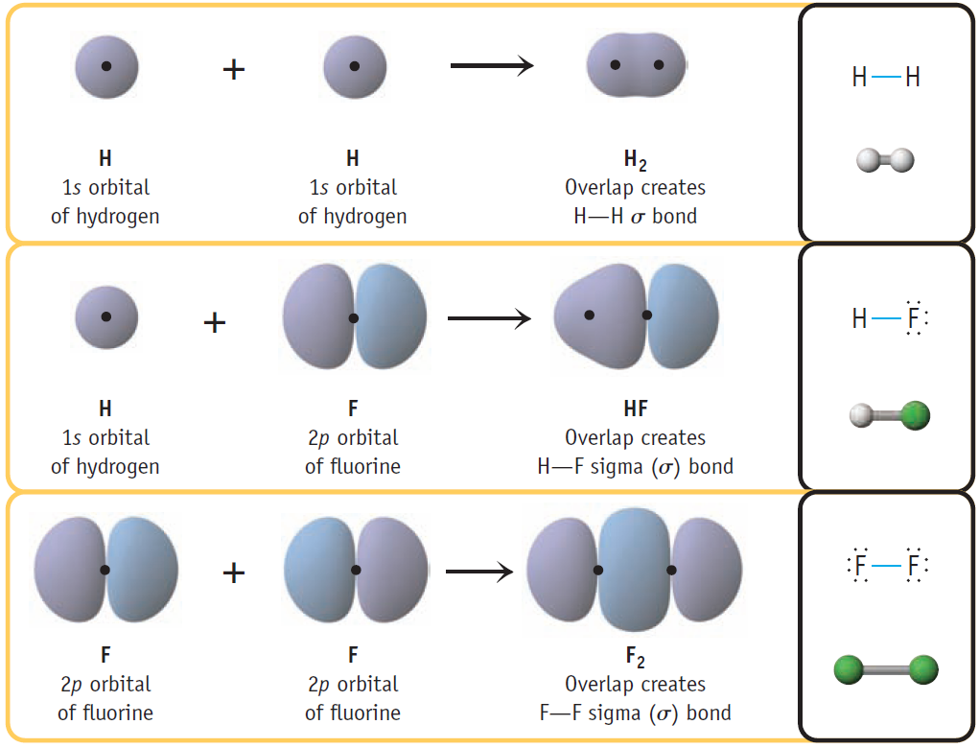

Slide 6
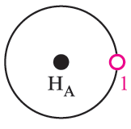
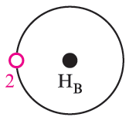

Slide 7
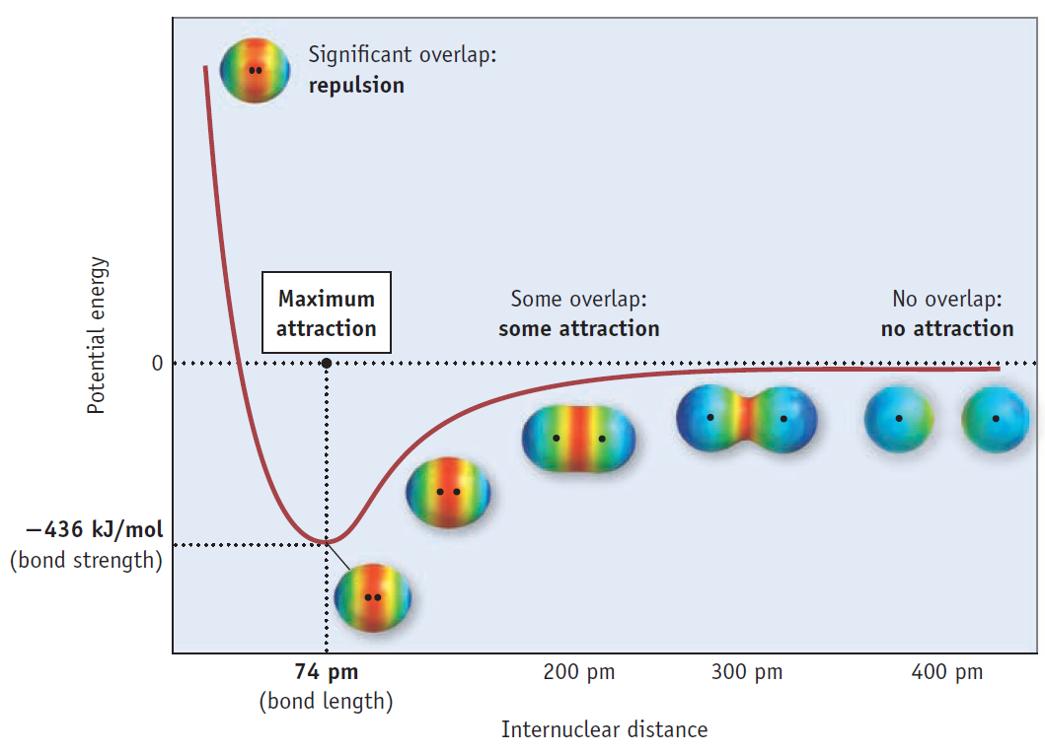

Slide 8
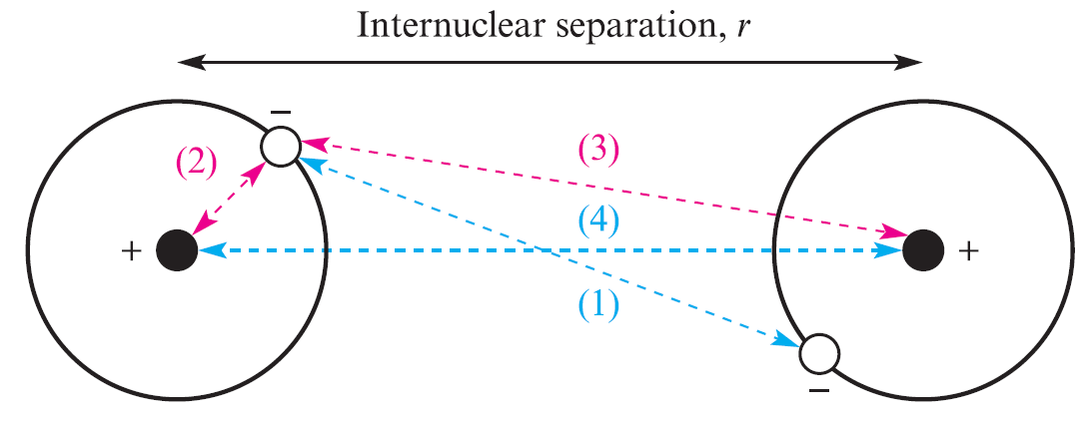
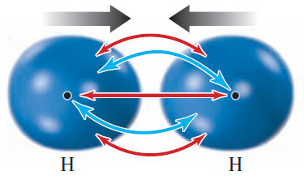
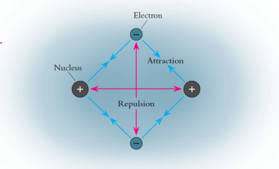

Slide 9
1. System of two isolated H atoms:
Type of wavefunctions | Energy (kJmol‾¹) | Distance (pm)
Uncorrected ψ=ψ_{A}ψ_{B} | 24 | 90
Observed Values | 458.0 | 74.1

Slide 10
2. Exchange of electrons between the two H atoms:
Type of wavefunctions | Energy (kJmol‾¹) | Distance (pm)
Uncorrected ψ=ψ_{A}ψ_{B} | 24 | 90
Heitler-London | 303 | 86.9
Observed Values | 458.0 | 74.1

Slide 11
3. Addition of Shielding – The effective atomic number (Z*) in H₂ is less than the Z in H atom
Type of wavefunctions | Energy (kJmol‾¹) | Distance (pm)
Uncorrected ψ=ψ_{A}ψ_{B} | 24 | 90
Heitler-London | 303 | 86.9
Addition of Shielding | 365 | 74.3
Observed Values | 458.0 | 74.1

Slide 12
4. Chances of finding both electrons in one H atom – ionic structures
Type of wavefunctions | Energy (kJmol‾¹) | Distance (pm)
Uncorrected ψ=ψ_{A}ψ_{B} | 24 | 90
Heitler-London | 303 | 86.9
Addition of Shielding | 365 | 74.3
Addition of ionic contributions | 388 | 74.9
Observed Values | 458.0 | 74.1

Slide 13
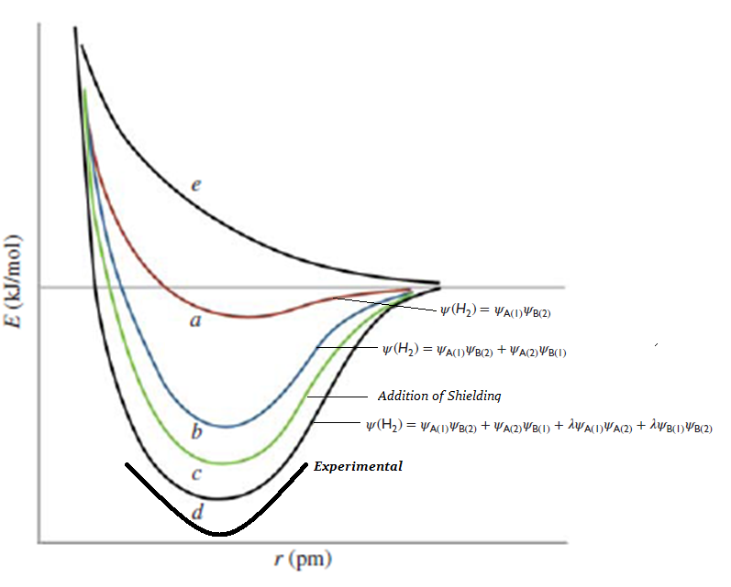

Slide 14
Covalent structure
I o n i c s t r u c t u r e s
The wave function for H₂ can be written as:

Slide 15
Resonance
Covalent structure
I o n i c s t r u c t u r e s
It is possible to draw more than one valid Lewis structure for a molecule
In such cases, the true bonding can be considered as a resonance hybrid of the different canonical forms

Slide 16
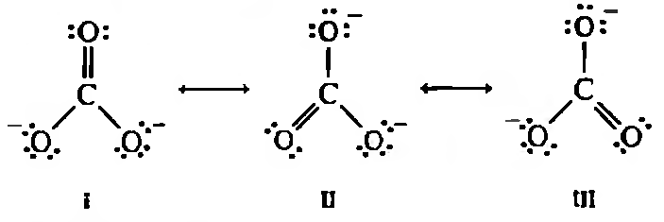

Slide 17
Resonance has two main effects:
• Resonance averages the bond characteristics over the molecule
• The energy of a resonance hybrid structure is lower than that of any single contributing structure

Slide 18
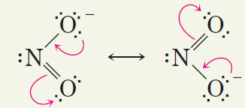

Slide 19
The contribution of a canonical structure to the hybrid is inversely proportional to its energy
High energy, unstable structures contribute very little
For resonance to be appreciable, the energies of the contributing structures must be comparable (eg. Carbonate anion)

Slide 20
Rules of Resonance
1. The proposed canonical structure should have a maximum number of bonds

Slide 21
2. The proposed canonical structures must be consistent with the location of the atoms in the actual molecule – Tautomers are not possible resonance structures
These two structures are
tautomers - not resonance forms

Slide 22
Three possible resonance structures for N₂O:
But the following is not a possible candidate as the bond angles in it are different:

Slide 23
3. Distribution of formal charges in a contributing structure must be reasonable
Canonical forms in which adjacent like charges appear
will be unstable:

Slide 24
When placing opposite charges on adjacent atoms
– remember their electronegativity
Placement of adjacent charges of opposite sign will be more favorable than when these charges are separated

Slide 25
4. There must be the same number of unpaired electrons (if any) in all structures

Slide 26
Formal Charge (FC)
Formal charge – the charge that an atom in a molecule would have if all of the atoms had the same electronegativity
That is if all the electrons are assumed to be shared equally by the constituting atoms

Slide 28
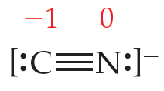

Slide 30
Hybridization

Slide 31
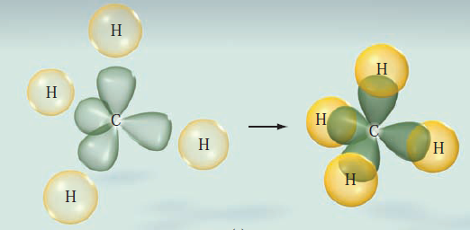

Slide 34
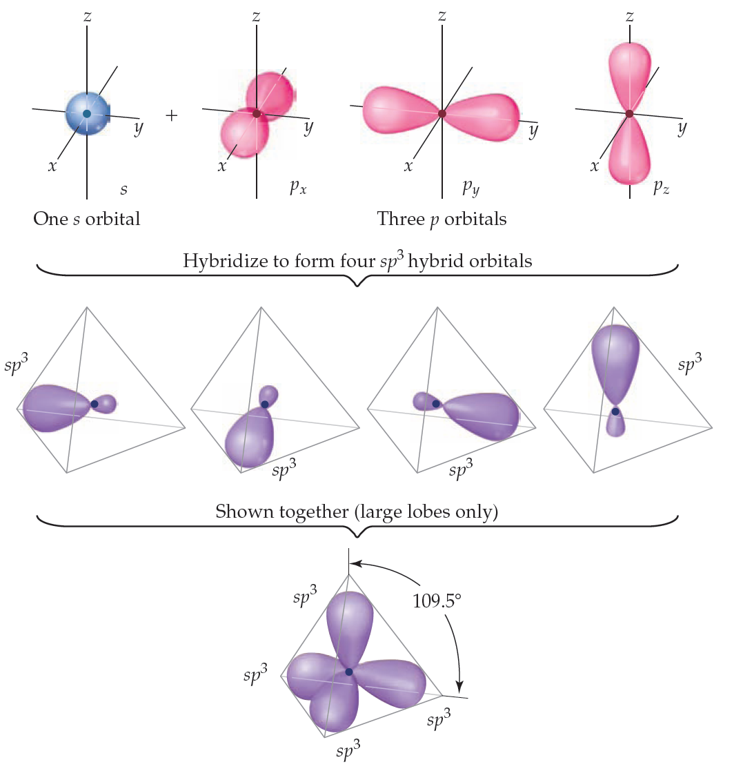
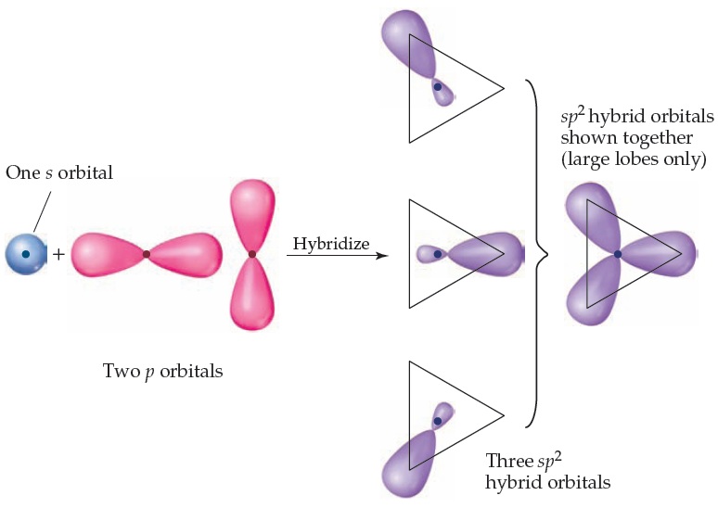
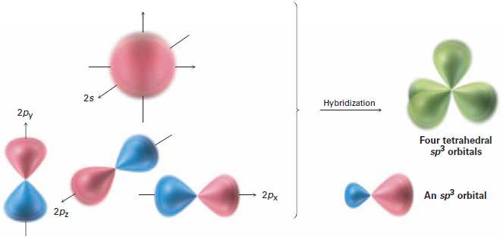

Slide 35
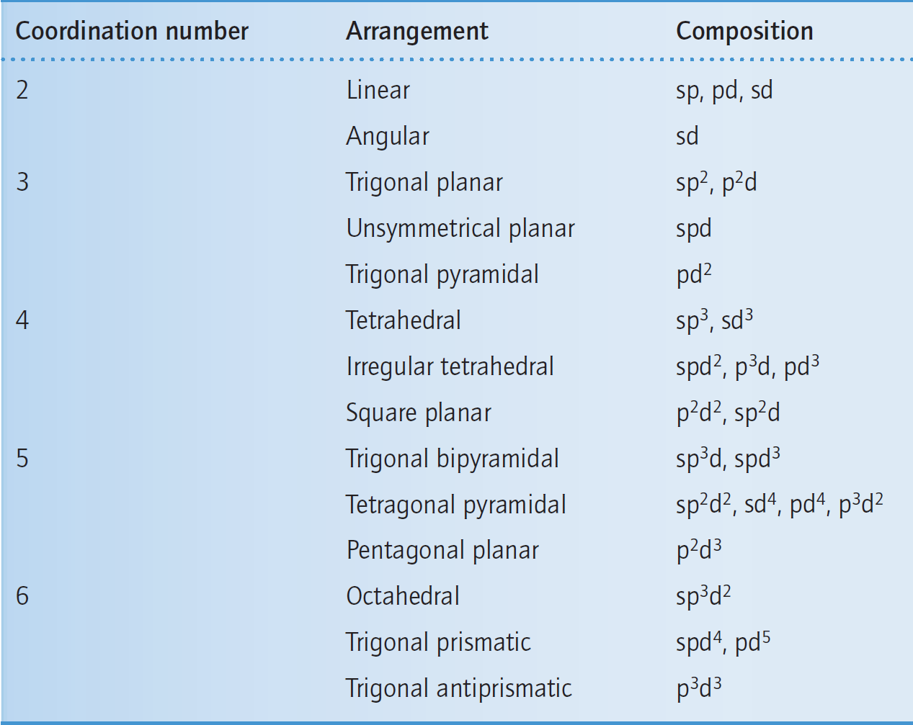

Slide 36
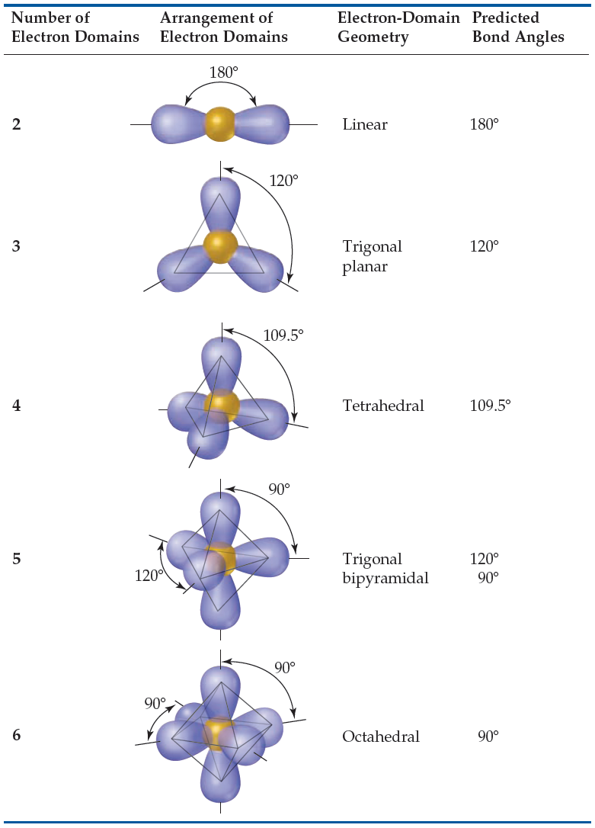

Slide 37
Effect of Hybridization on overlap and bond properties
The relative overlap: sp > sp² > sp³ > p
Molecule | Hybridization | C-H Bond Energy (kJmol‾¹) | C-H Bond Length (pm)
H-C≡C-H | sp | 500 | 106.1
H₂C=CH₂ | sp² | 400 | 108.6
CH₄ | sp³ | 410 | 109.3
CH radical | ∼ p | 335 | 112.0

Slide 38
Molecular Orbital Theory (MOT)
Assumptions
if two nuclei are positioned at an equilibrium distance, and electrons are added, they will go into molecular orbitals that are in many ways analogous to the atomic orbitals
In the atom there are s, p, d, f, . . . orbitals determined by various sets of quantum numbers and in the molecule we have σ, π, δ, . . . orbitals determined by quantum numbers
The Pauli exclusion principle and Hund's principle of maximum multiplicity are obeyed in these molecular orbitals as well as in the atomic orbitals

Slide 39
The approximation method of choice is the LCAO-MO method, which is an acronym that stands for linear combinations of atomic orbitals to make molecular orbitals
Unlike VBT, however, the linear combinations used to construct MOs derive from the AOs on two or more different nuclei, whereas the linear combinations used to make hybrid orbitals in VBT involved only the valence orbitals on the central atom

Slide 40
The first principle of molecular orbital theory is that the total number of molecular orbitals is always equal to the total number of atomic orbitals contributed by the atoms that have combined.

Slide 41
A second principle of molecular orbital theory is that the bonding molecular orbital is lower in energy than the parent orbitals, and the antibonding orbital is higher in energy

Slide 42
A third principle of molecular orbital theory is that the electrons of the molecule are assigned to orbitals of successively higher energy according to the Pauli exclusion principle and Hund’s rule

Slide 43
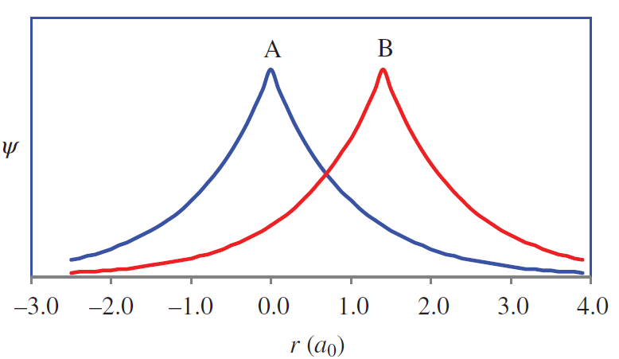
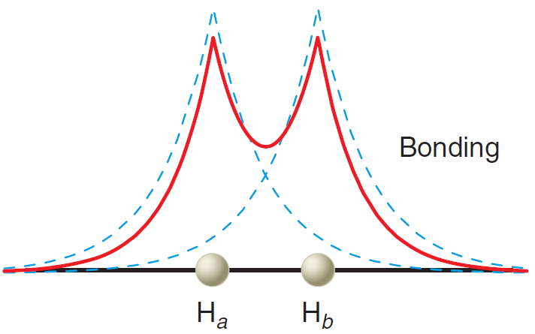

Slide 44
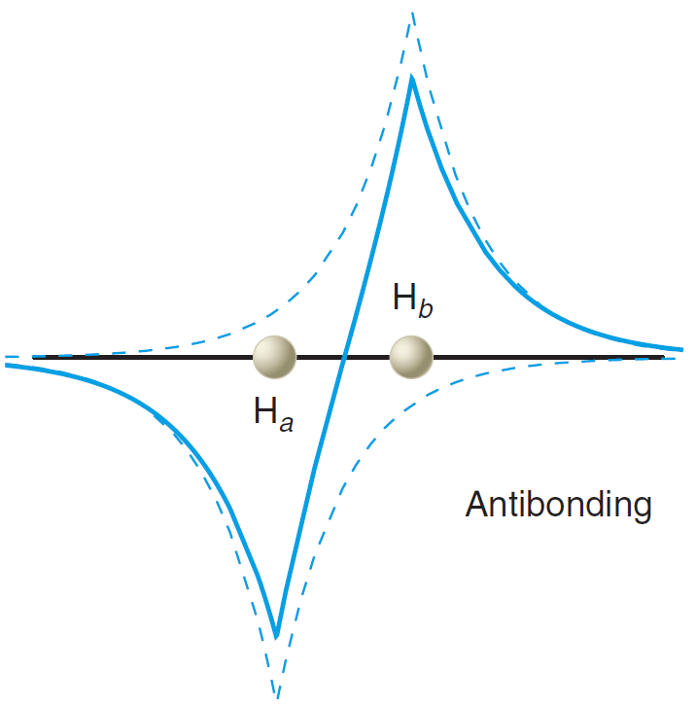

Slide 45
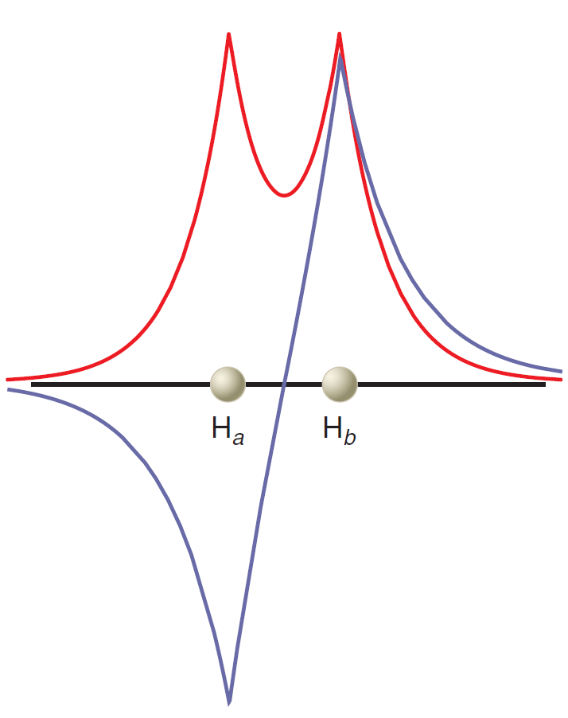

Slide 47
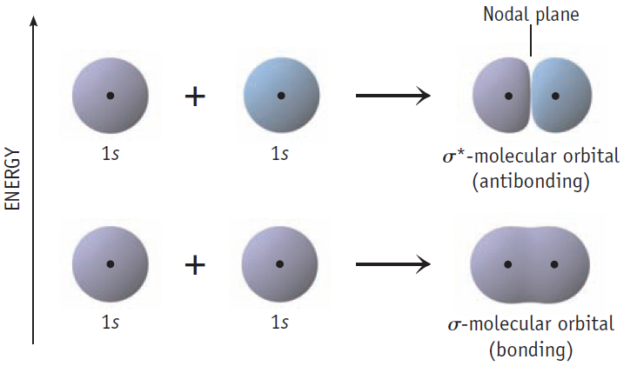

Slide 48
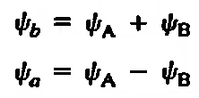
The two orbitals ψ_{b} and ψ_{a} differ from each other as follows
In the bonding molecular orbital the wave functions for the component atoms reinforce each other in the region between the nuclei
But in the anti bonding molecular orbital they cancel, forming a node between the nuclei

Slide 49
The electron densities in H₂ are of more importance which are given by the square of wave functions:

Slide 50
The difference between the two probability functions lies in the cross term 2ψ_{a} ψ_{b}
The integral ∫2ψ_{a} ψ_{b} is known as the overlap integral, S, and is very important in bonding theory
In the bonding orbital the overlap is positive and the electron density between the nuclei is increased, whereas in the antibonding orbital the electron density between the nuclei is decreased.

Slide 51
Normalization of wave function – probability of finding an electron somewhere in space is one. Mathematically,
∫ψ²dτ = 1
The equation then becomes
Where N_{b} is the normalization constant

Slide 52
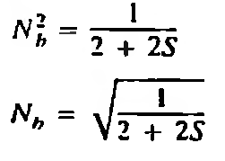
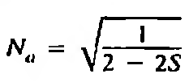
Putting S = ∫2ψ_{a} ψ_{b}
Since the atomic wave functions ψ_{a} and ψ_{b} were previously normalized, ∫ψ_{A}²dτ = 1 and ∫ψ_{A}²dτ = 1. Hence,

Slide 53
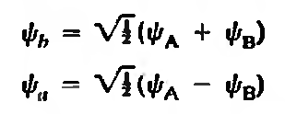
For most simple calculations, S is rather small and both N_{b} and N_{a} can be simplified to √1/2, and

Slide 54
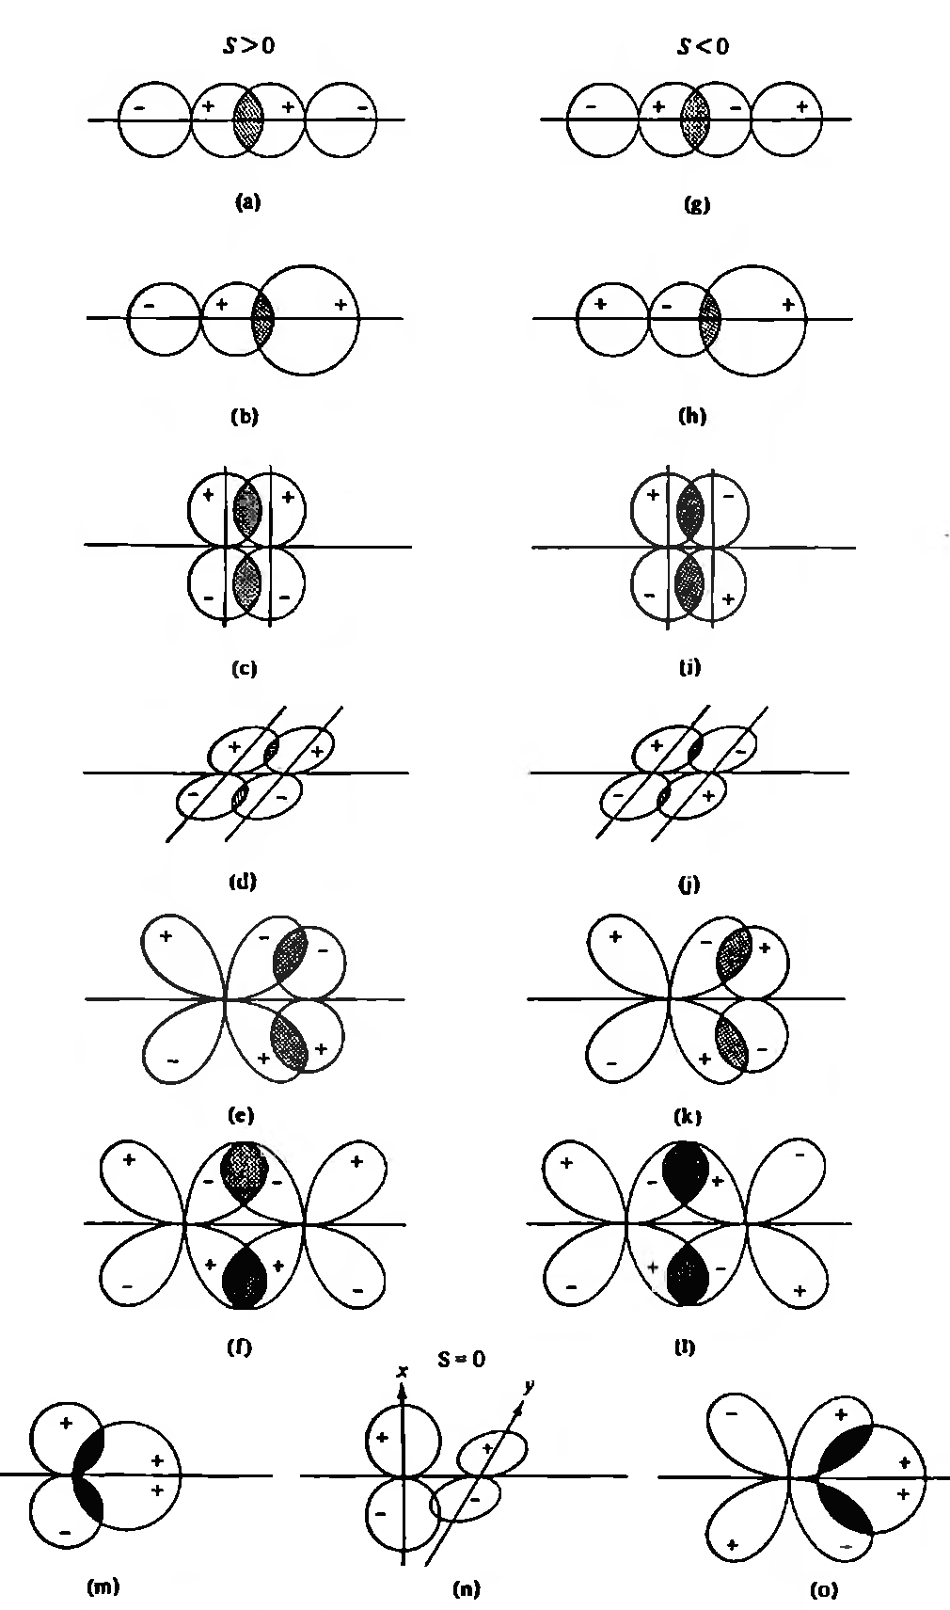
a-f: Positive overlap
g-l: negative overlap
m-o: zero overlap

Slide 55
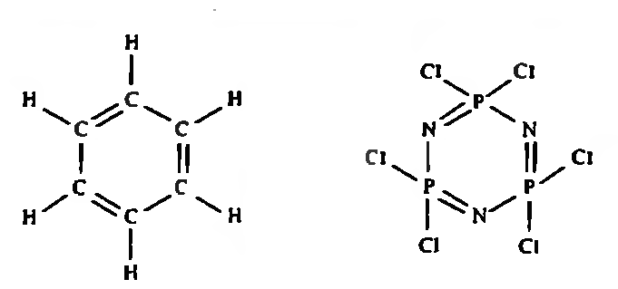
The overlap, S to be positive is very essential in bonding
Benzene – aromatic
Inorganic benzene – less aromatic

Slide 56
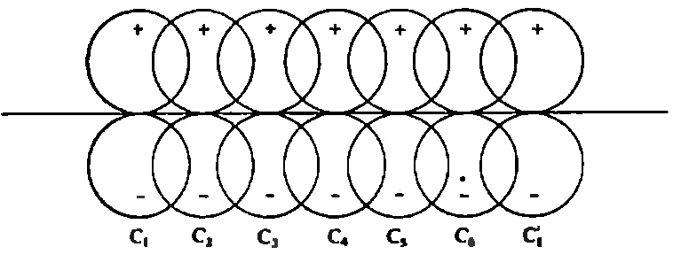
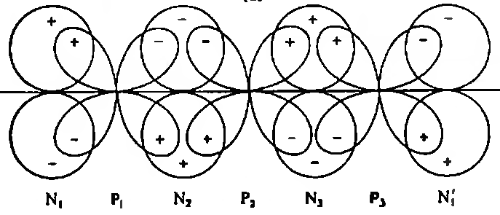

Slide 57
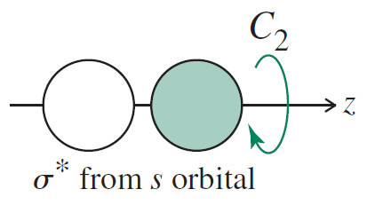
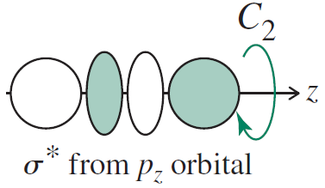
Symmetry of Molecular Orbitals
Those orbitals which are cylindrically symmetrical about the internuclear axis (that are symmetric to rotation about the line connecting the nuclei) are called σ orbitals, analogous to an s orbital, the atomic orbital of highest symmetry

Slide 58
All antibonding orbitals (identified with an *) possess an additional nodal plane perpendicular to the internuclear axis and lying between the nuclei

Slide 59
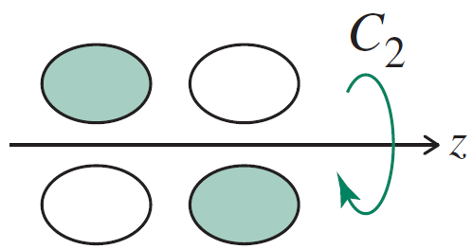
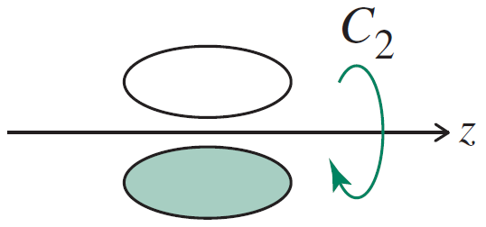
If the internuclear axis lies in a nodal plane,
a π bond results
π_{p-p}
π∗_{p-p}
π_{p-p} orbitals, which are ungerade, and π∗_{p-p} orbitals, which are gerade

Slide 60
In δ bonds the internuclear axis lies in two mutuaIly perpendicular nodal planes

Slide 61
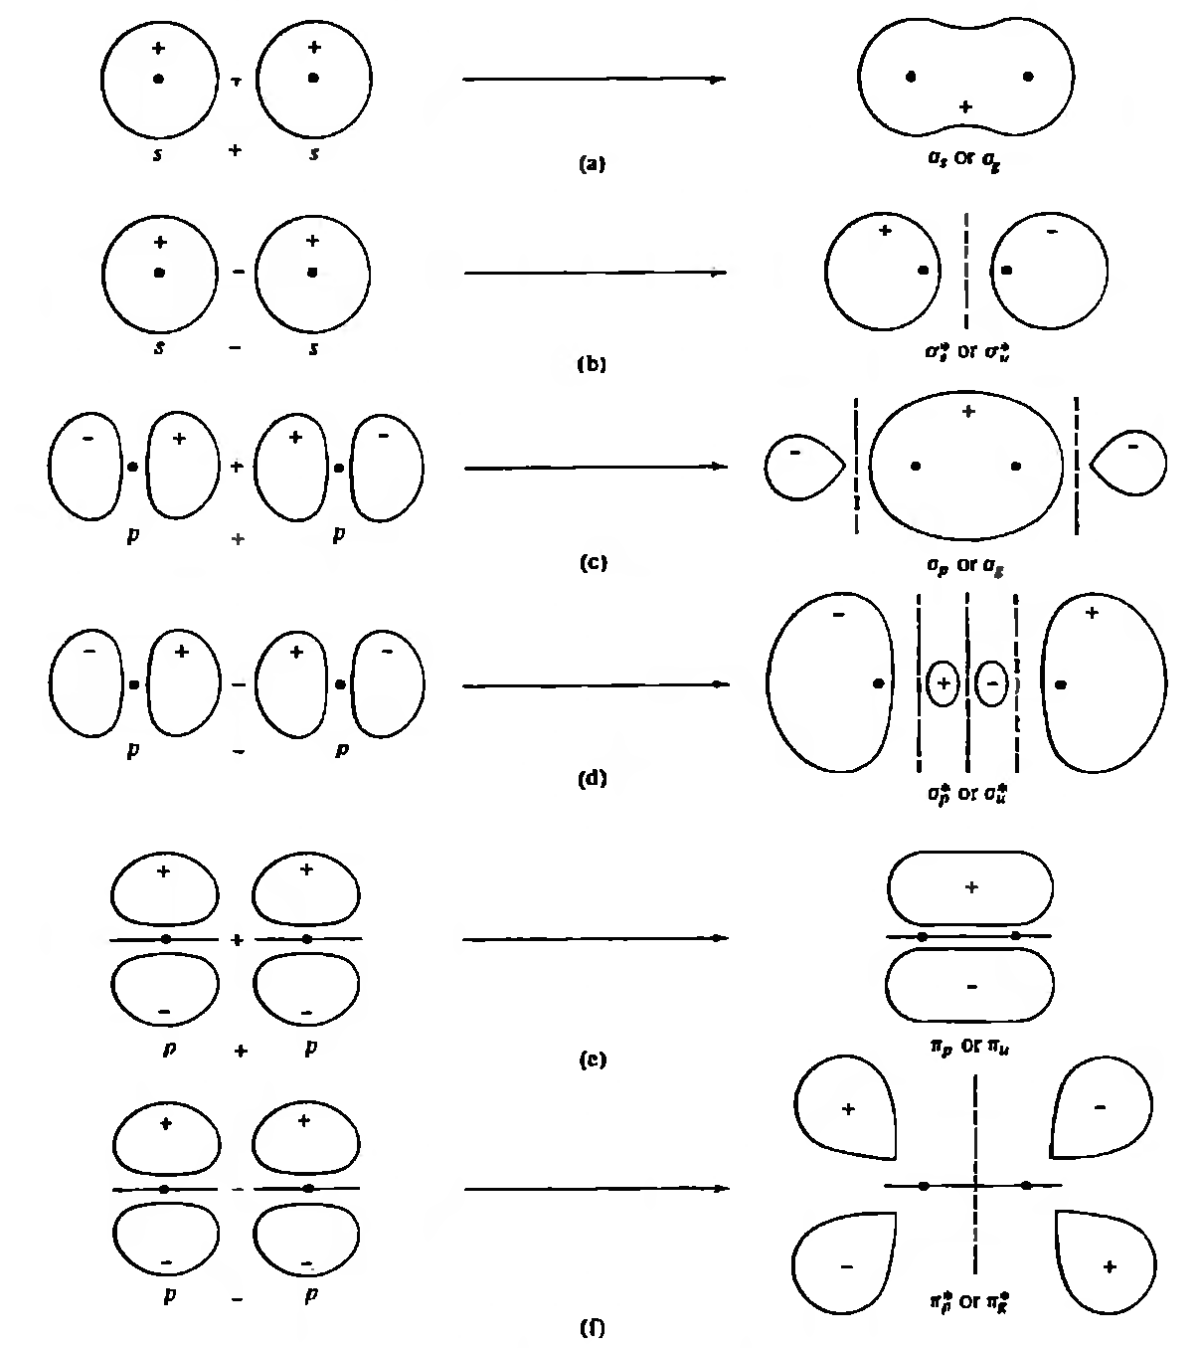
Symmetry of Molecular Orbitals

Slide 62
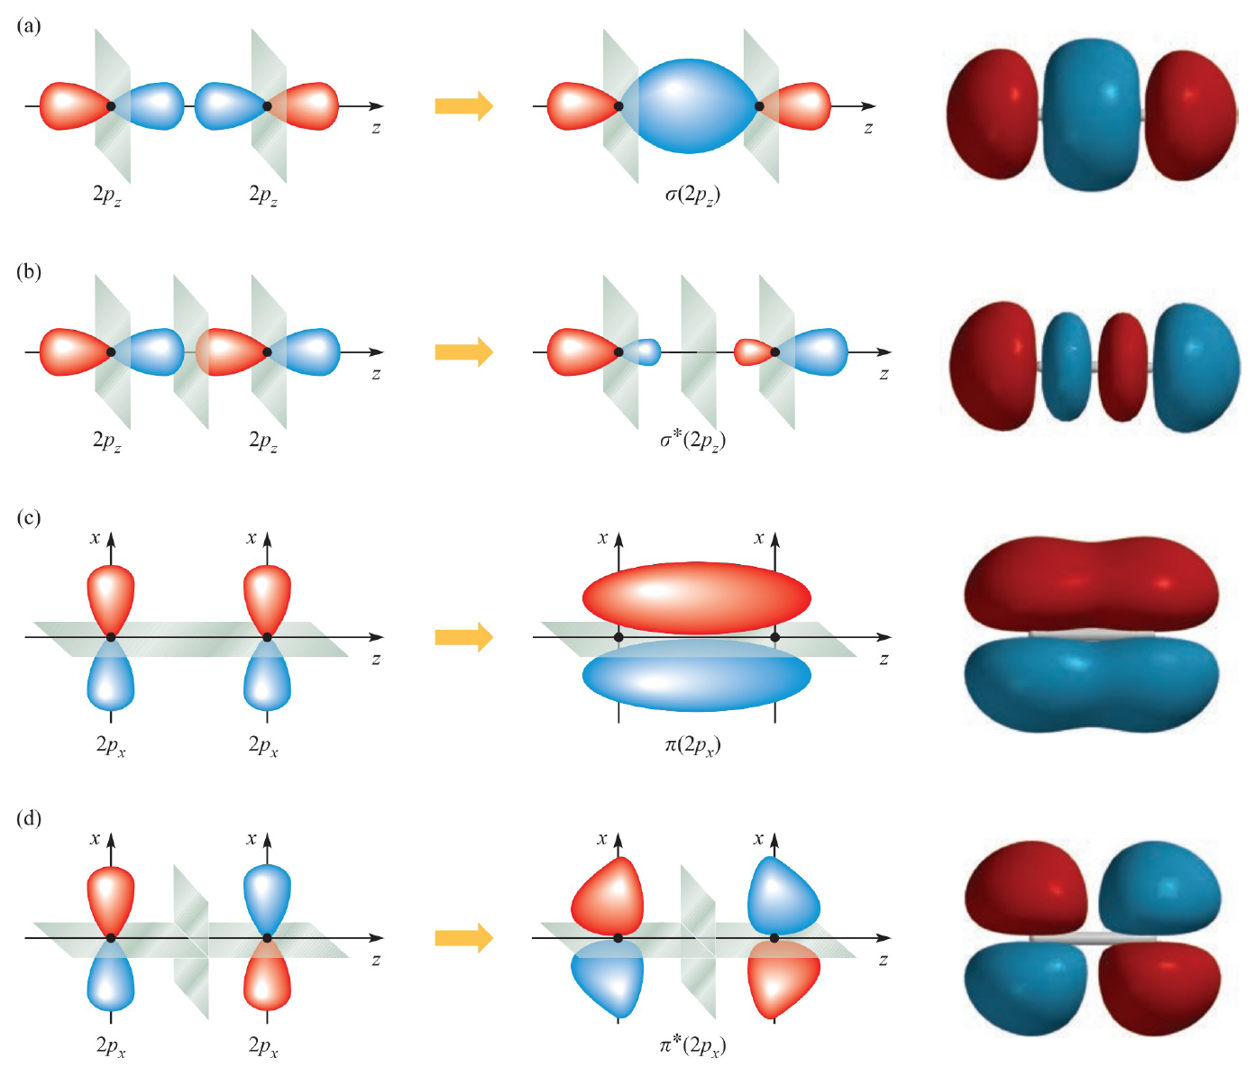
Symmetry of Molecular Orbitals

Slide 63
There are two criteria that must be met for the formation of bonding molecular orbitals:
the overlap between the atomic orbitals must be positive
the energies of the atomic orbitals must be approximately the same

Slide 64
Homonuclear Diatomics

Slide 65
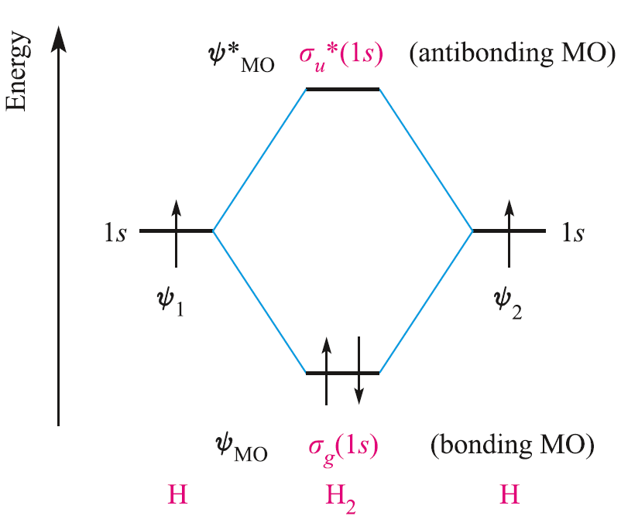
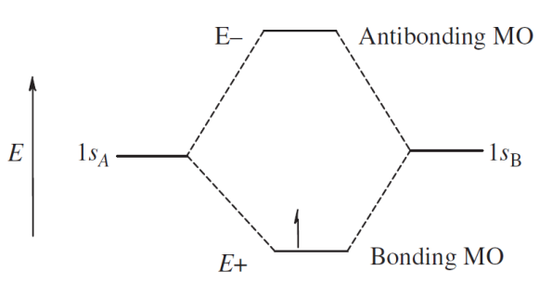
The ground state electronic configuration of H₂
H₂ = σ_{1s}²

Slide 66
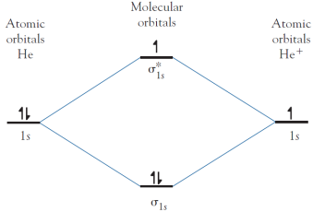
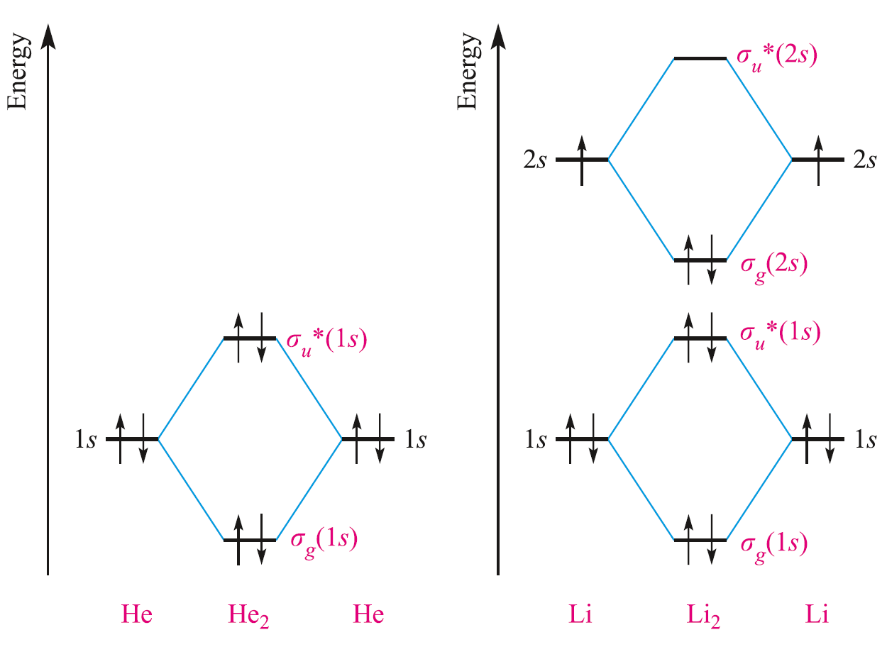
Li₂ = σ_{1s}² σ*_{1s}² σ_{2s}²
= ΚΚσ_{2s}²
He₂ = σ_{1s}² σ*_{1s}²

Slide 67
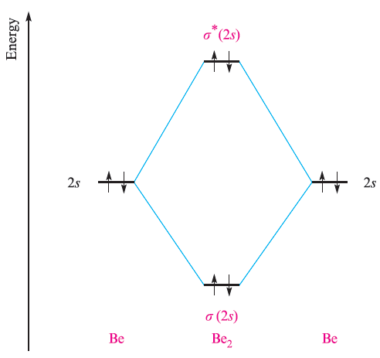
Be₂ = σ_{2s}² σ*_{2s}²

Slide 69
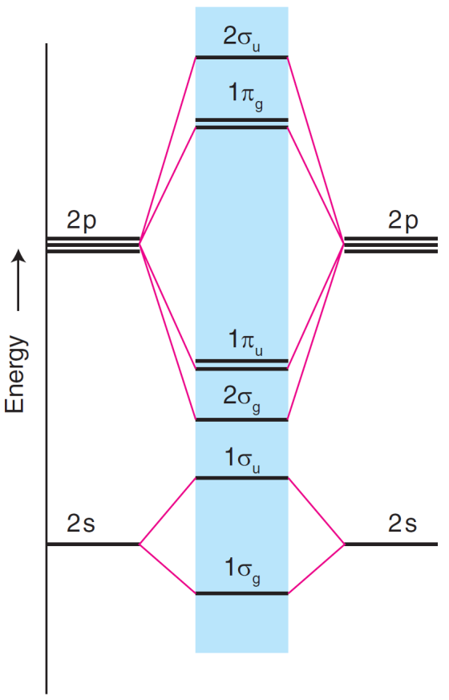
Oxygen, Fluorine, and Neon
O₂ = KK σ_{2s}² σ*_{2s}² σ_{2p}² π_{2p}⁴ π∗_{2px}¹ π∗_{2py}¹
F₂ = KK σ_{2s}² σ*_{2s}² σ_{2p}² π_{2p}⁴ π∗_{2p}⁴
Ne₂ does not exist

Slide 70
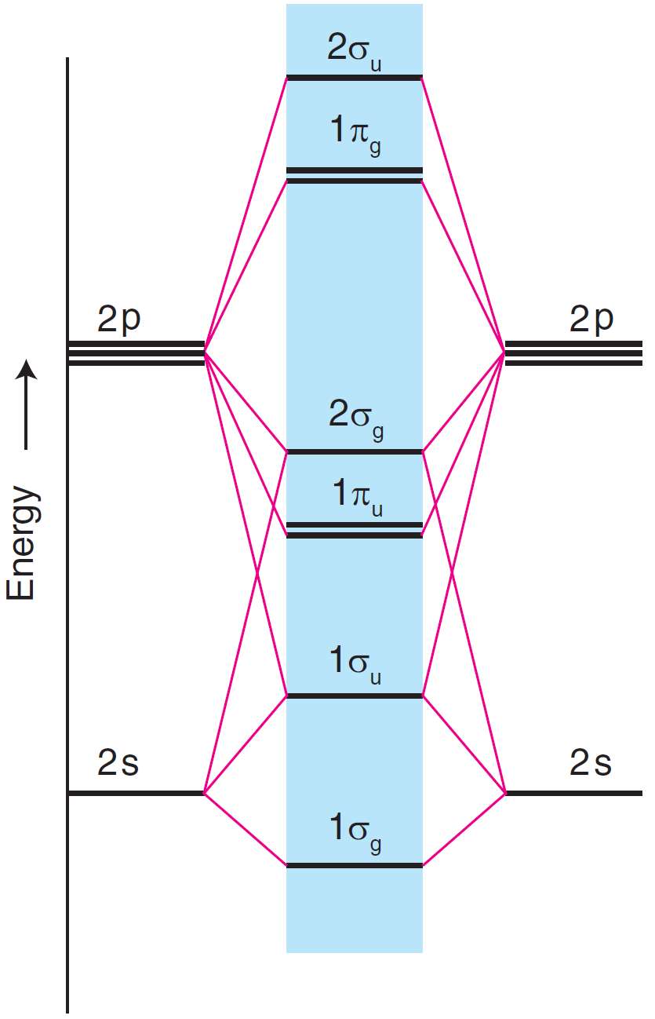
Boron, Carbon and Nitrogen
orbital mixing and σ−π crossover

Slide 71
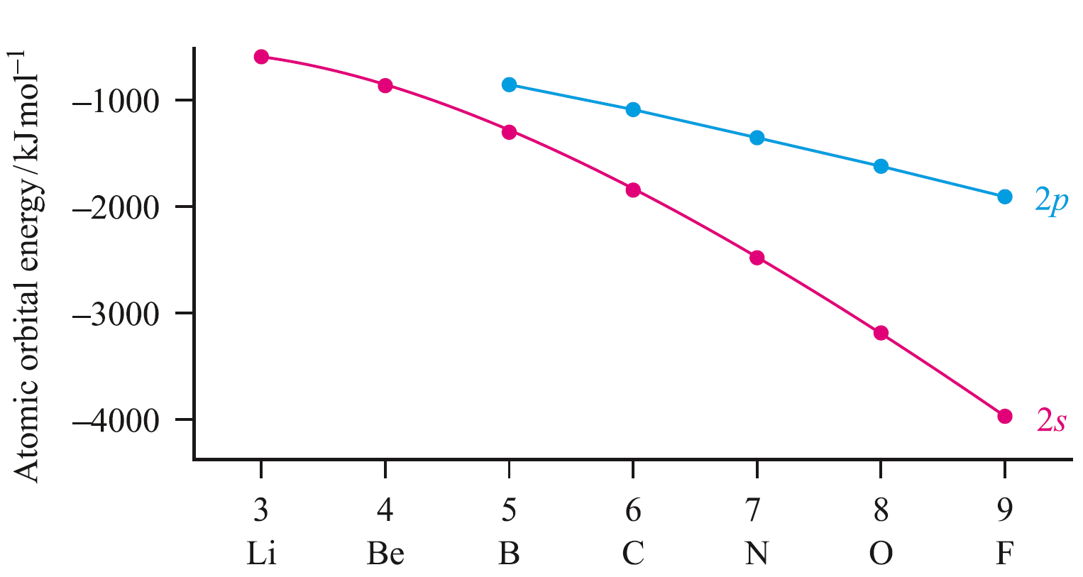

Slide 72
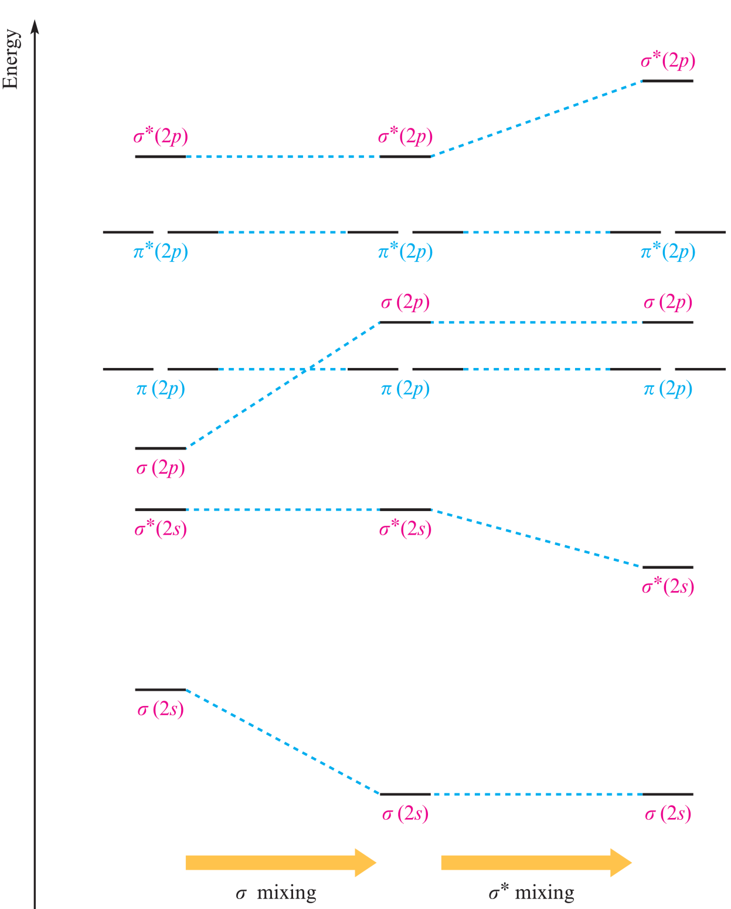
E_{2p} – E_{2s}
B – 550kJ/mol
F – 2100kJ/mol

Slide 73
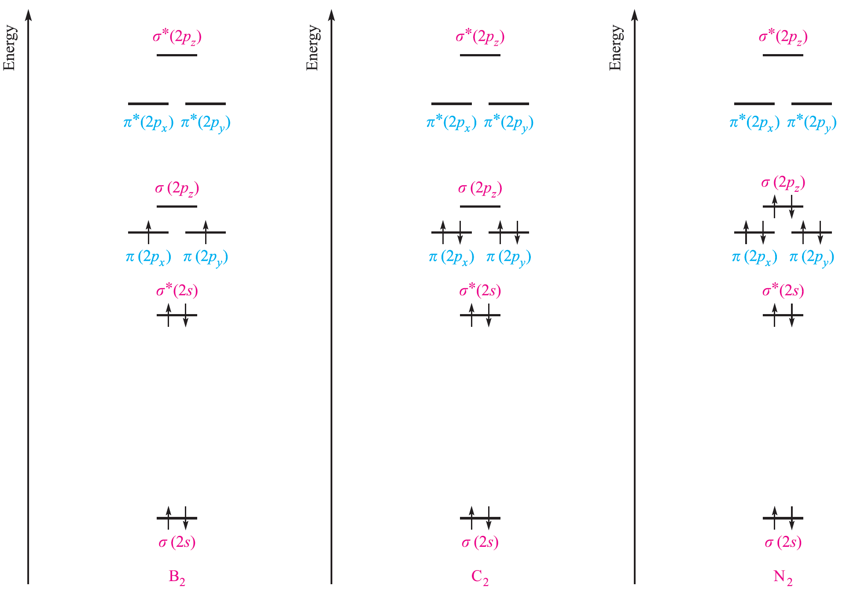

Slide 74
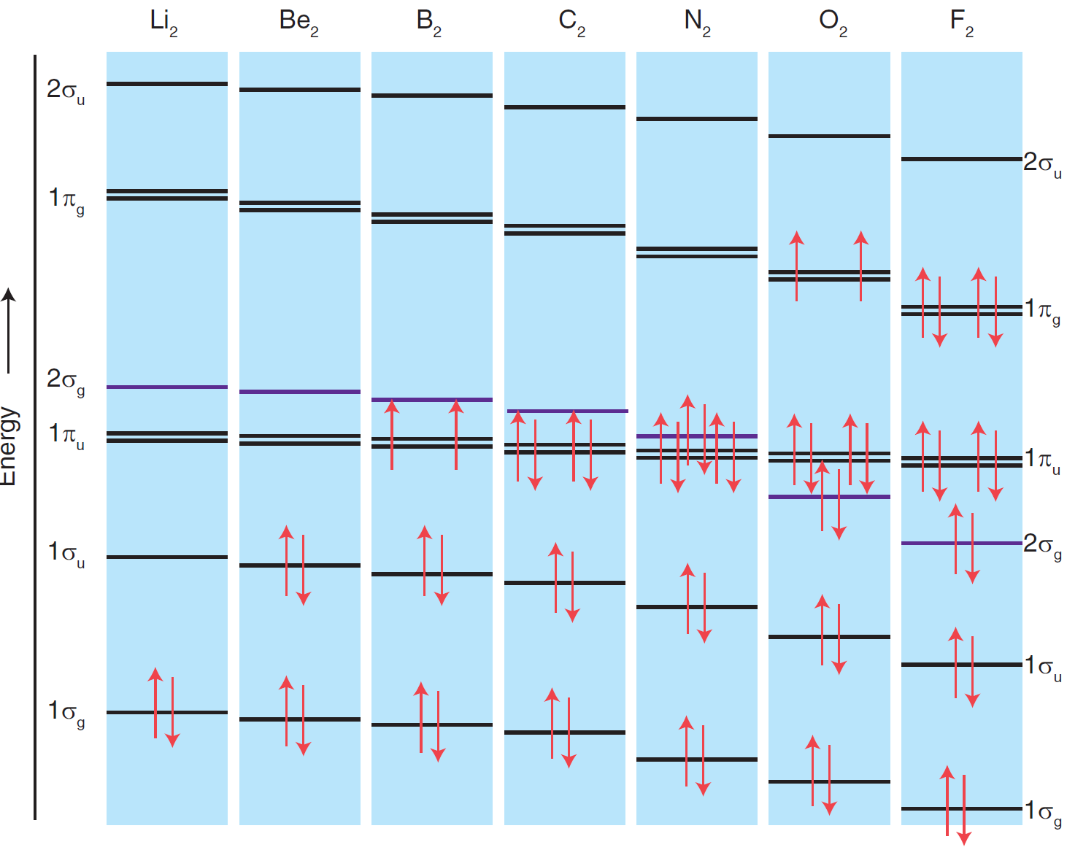

Slide 75
Diatomic species | O–O bond order | O–O bond length (pm) | Bond Enthalpy (kJ/mol) | Magnetic Behavior
O₂ | 2 | 121 | 498 | Para
O₂⁺ | 2.5 | 112 | 644 | Para
O₂– | 1.5 | 134 (126) | 360 | Para
O₂^{2–} | 1 | 149 | 149 | Dia

Slide 76
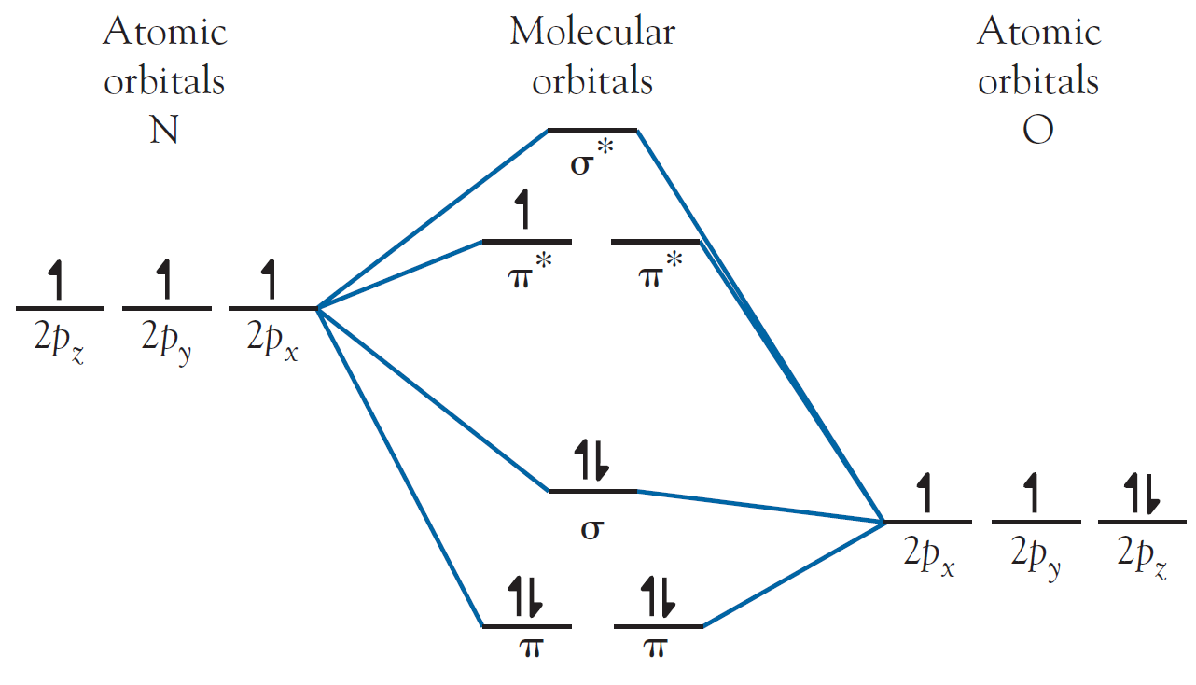
NO
Bond order = 2.5
Bond length = 115 pm
Paramagnetic
NO⁺
Bond order = 3.0
Bond length = 106 pm
Diamagnetic
IE of O₂ = 1164 kJ/mol
IE of N₂ = 1503 kJ/mol
IE of NO = 894 kJ/mol
IE of NO⁺ = 1069 kJ/mol

Slide 77
Heteronuclear diatomics
The ABMO lies closer to the AO of the less electronegative element
Covalent Energy is reduced
The BMO lies closer to the AO of the more electronegative element

Slide 78
The BMO is very similar to the more electronegative element
It is more centered on Y
Greater Y character
The ABMO is very similar to the less electronegative element
It is more centered on X
Greater X character

Slide 79
Covalent Energy is further reduced

Slide 82
CO
In CO the BMOs will resemble the atomic AOs of oxygen more than they resemble those of carbon.
The ABMOs resemble the least electronegative element, carbon

Slide 84
Another feature of heteronuclear molecular is the diminished covalent energy of bonds formed from atomic orbitals or different energies.

Slide 85
HCl

Slide 86
BeH₂

